Slide 1
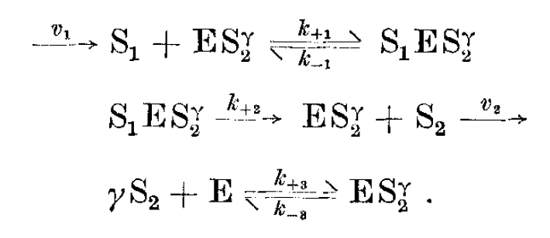
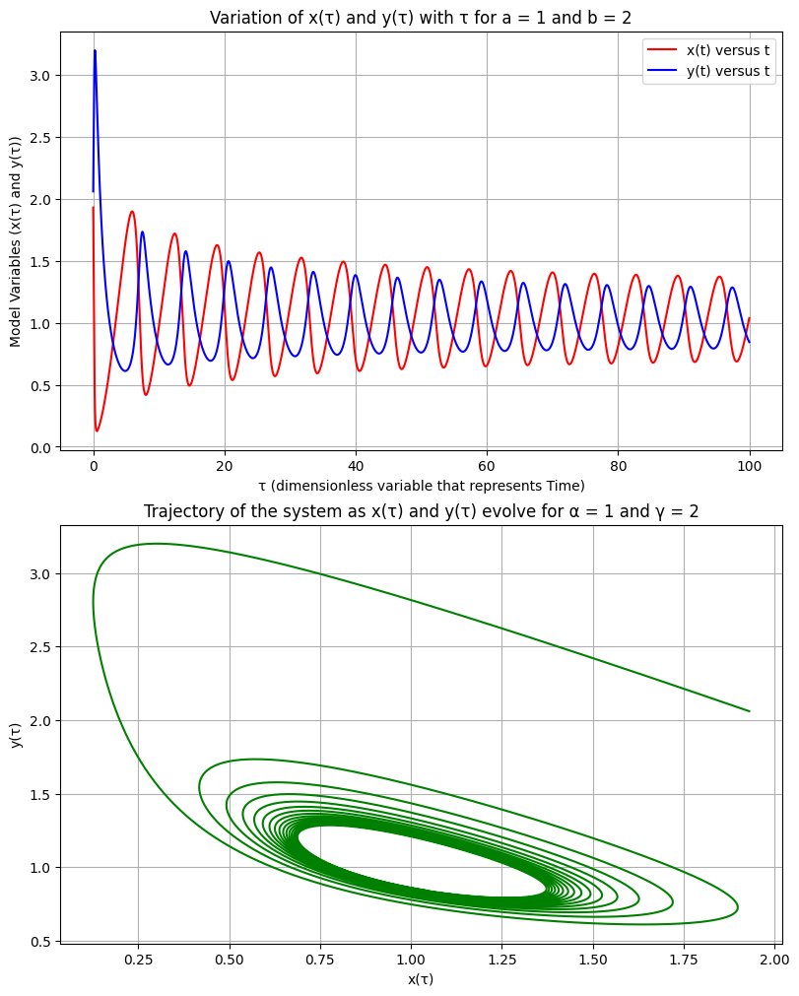
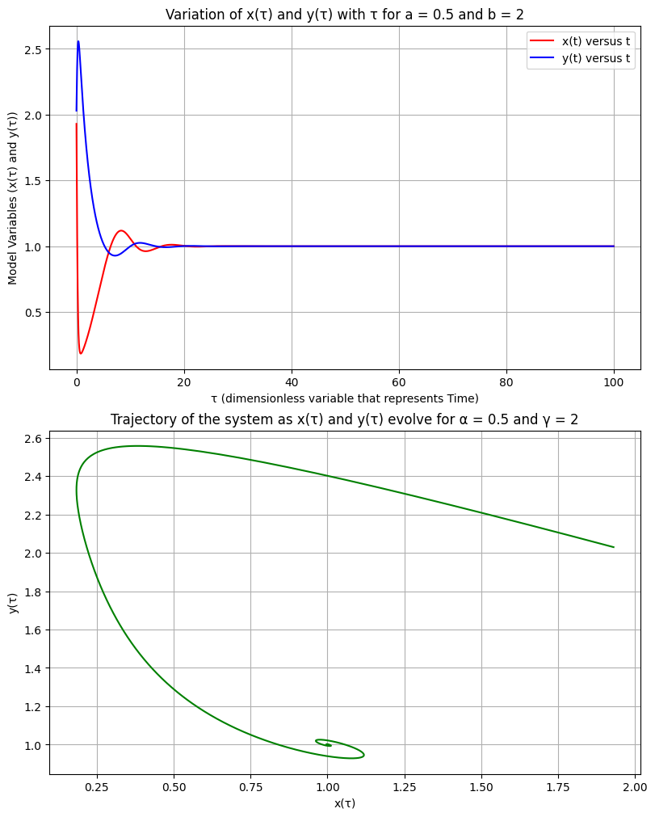
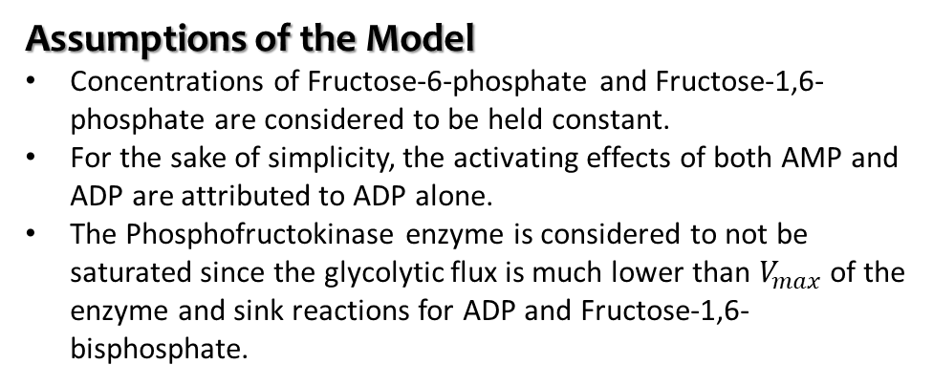
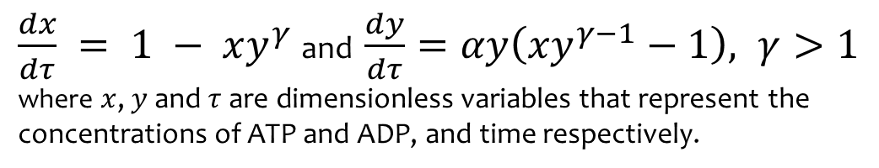
The Se’lkov Model of Oscillations during Glycolysis (Se’lkov, 1986)
Description of the Model
An open monosubstrate enzyme reaction with substrate inhibition and product inhibition, as a model for the reaction catalysed by Phosphofructokinase, which utilizes ATP to phosphorylate Fructose-6-Phosphate, producing ADP and Fructose-1,6-bisphosphate during Glycolysis.
The model provides conditions under which limit cycle oscillations can arise in such reaction systems, which align with experimental conditions.
Limitations
The model does not consider the occurrence of double-frequency oscillations, reversible substrate sources, and the presence of multiple alternative steady states.
Reaction Scheme
S₁ – ATP
S₂– ADP
E - Enzyme
ES₂^{γ} – transition state of the enzyme
S₁ES₂^{γ}– active form
Aspects of the Model
Equations of the Model
Deterministic
Single-scale
$\frac{dx}{dτ} = 1 − xy^{γ}$ and $\frac{dy}{dτ}=αy\left(xy^{γ−1}−1\right), γ>1$
where $x$, $y$ and $τ$ are dimensionless variables that represent the concentrations of ATP and ADP, and time respectively.
Dynamic
Continuous-time
Mechanistic (the model is based on a mechanism of the reaction catalysed by Phosphofructokinase)
Assumptions of the Model
Concentrations of Fructose-6-phosphate and Fructose-1,6-phosphate are considered to be held constant.
For the sake of simplicity, the activating effects of both AMP and ADP are attributed to ADP alone.
The Phosphofructokinase enzyme is considered to not be saturated since the glycolytic flux is much lower than $V_{max}$ of the enzyme and sink reactions for ADP and Fructose-1,6-bisphosphate.
Model Simulation (code can be found here)
(a)
(b)
Depicts Limit Cycle Oscillations.
Depicts behaviour around a Stable Node.

Slide 2
Constraint-based Modelling for the study of Polymicrobial Infections
Motivation for the project
Current status
GEMs have been used to study the integrated host-pathogen metabolic networks and the metabolism of pathogens during co-infections in culture media.
However, models that integrate the host metabolic network with the metabolic networks of multiple coinfecting pathogens in polymicrobial diseases have not been investigated.
This project aims to utilize previously published GEMs of the human small intestine epithelial cells, V. cholerae, and E. coli to construct an integrated metabolic network comprising the host cell and coinfecting pathogens.
Studied the co-infection model of V. cholerae, and E. coli by replicating the results in [1] by:
Performing gene deletion analysis
Analysing growth capabilities in different media, to study differences between the individual and co-infection models
Challenges
Several GEMs of the human or mouse small intestine have been published, but most do not follow the ‘best practices’ recommended by COBRApy.
Future Plans
Objectives of the project
Identification of a suitable host GEM and integration of the host and co-infection GEMs.
Performing gene essentiality and growth capabilities analysis, and comparing with individual and co-infection models.
Simulate the results of a previous study describing an integrated metabolic model of V. cholerae and E. coli.
Construct an integrated model of the metabolic networks of the small intestine epithelial cell, V. cholerae, and E. coli.
Define a suitable extracellular medium and objective function for the integrated model.
Perform gene deletion analysis to determine essential genes for the pathogens in the host-coinfection model, and determine if they vary from the individual and co-infection models.
Reference
Abdel-Haleem AM, Ravikumar V, Ji B, Mineta K, et al. Integrated Metabolic Modeling, Culturing, and Transcriptomics Explain Enhanced Virulence of Vibrio cholerae during Coinfection with Enterotoxigenic Escherichia coli. mSystems. 2020 Sep 8;5(5):e00491-20. doi: 10.1128/mSystems.00491-20.

